Slide 1
Evaluation of TCP westwood,westwood plus and TCP LEDBAT with Proposed TCP
By : Sandeep Singh
16CS16F

Slide 2
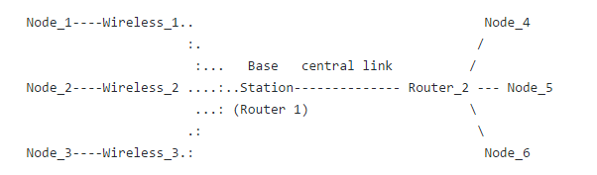
Topology

Slide 3
The capacity of the central link is 100 Mbps, with a one-way delay of 2 ms. All links to Router 2 are wired. Router 1 acts as a base station for a shared wireless IEEE 802.11g links. Although 802.11g has a peak bit rate of 54 Mbps, its typical throughput rate is much lower, and decreases under high loads and bursty traffic. The scales specified here are based on a nominal rate of 6 Mbps

Slide 4
TCP Westwood
TCP Westwood (TCPW) is a sender-side-only modification to TCP New Reno that is intended to better handle large bandwidth-delay product paths (large pipes), with potential packet loss due to transmission or other errors (leaky pipes), and with dynamic load (dynamic pipes).

Slide 5
TCP Westwood plus
TCP Westwood+ is a sender-side only modification of the TCP Reno protocol stack that optimizes the performance of TCP congestion control over both wireline and wireless networks. TCP Westwood+ is based on end-to-end bandwidth estimation to set congestion window and slow start threshold after a congestion episode, that is, after three duplicate acknowledgments or a timeout. The bandwidth is estimated by properly low-pass filtering the rate of returning acknowledgment packets

Slide 6
TCP LEDBAT
Low Extra Delay Background Transport (LEDBAT) is a way to transfer data on the Internet quickly without clogging the network. LEDBAT was invented by Stanislav Shalunov and is used by Apple for software updates and by BitTorrent for most of its transfers. LEDBAT is estimated to carry 13–20% of Internet traffic. LEDBAT is a delay-based congestion control algorithm that uses all the available bandwidth while limiting the increase in delay, it does so by measuring one-way delay and using changes in the measurements to limit congestion that the LEDBAT flow itself induces in the network.

Slide 7
TCP PROPOSED
This TCP is based on LEDBAT.
Parameters taken from LEDBAT
Base Delay
Current Delay
Estimating Queueing Delay
When a packet is dropped due to congestion the queueing delay will be high for packets around it.When a packet is dropped due to channel error when the network is not congested the queueing delay will be low for the packets around it.

Slide 8
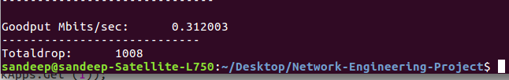
Results
TCP Westwood

Slide 9
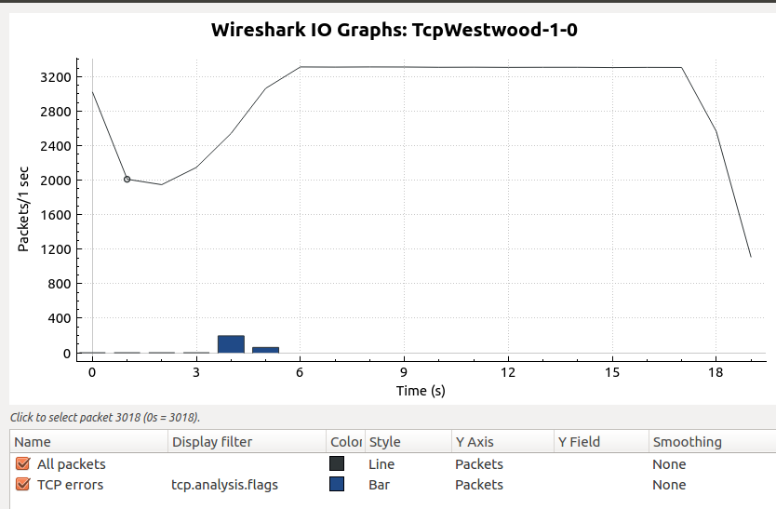

Slide 10

TCP Westwood plus

Slide 11
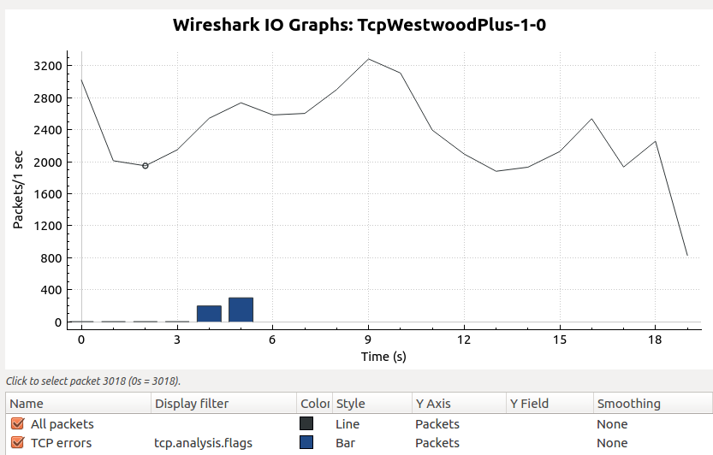

Slide 12
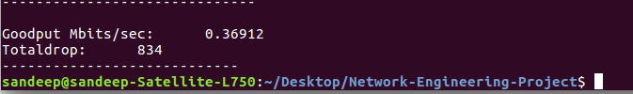
TCP LEDBAT

Slide 13
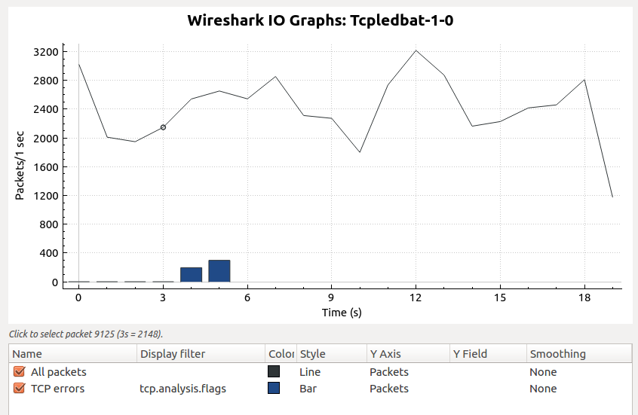

Slide 14

TCP Proposed

Slide 15
